Slide 1

Progress of the Laser-assisted H⁻ stripping injection in the CSNS-II
Ming-Yang Huang
Institute of High Energy Physics, Chinese Academy of Sciences
2026-10-15
# huangmy@ihep.ac.cn

Slide 2
Content
Introduction
Laser stripping injection for the CSNS-II RCS
Summary

Slide 3

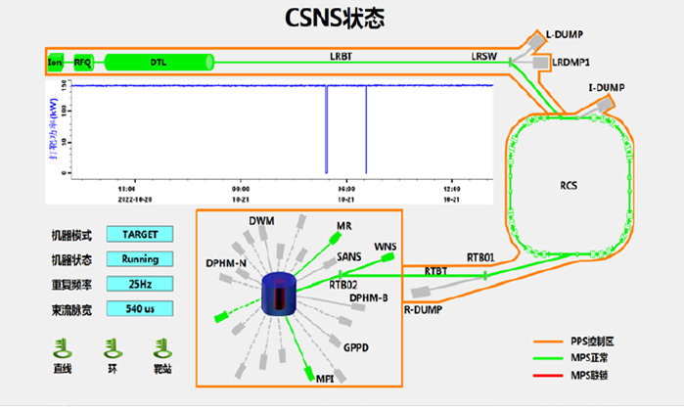
Ⅰ. Introduction
Budget: ￥1.86632 billion
Location: Dalang Town, Dongguan, Guangdong
Commencement Date: September 2011
Construction: 6.5 years, completed in March 2018
80 MeV Linac
1.6 GeV RCS
Target station
Three neutron spectrometers

Slide 4
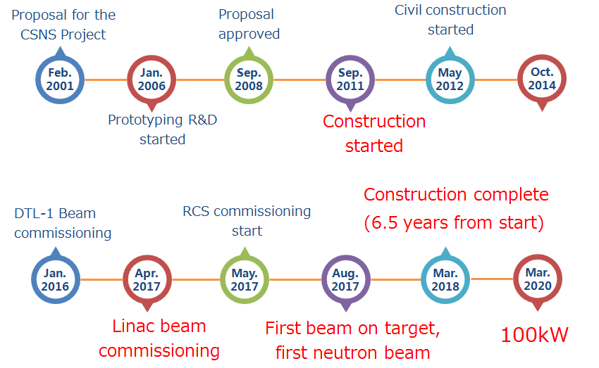
CSNS brief history

Slide 5
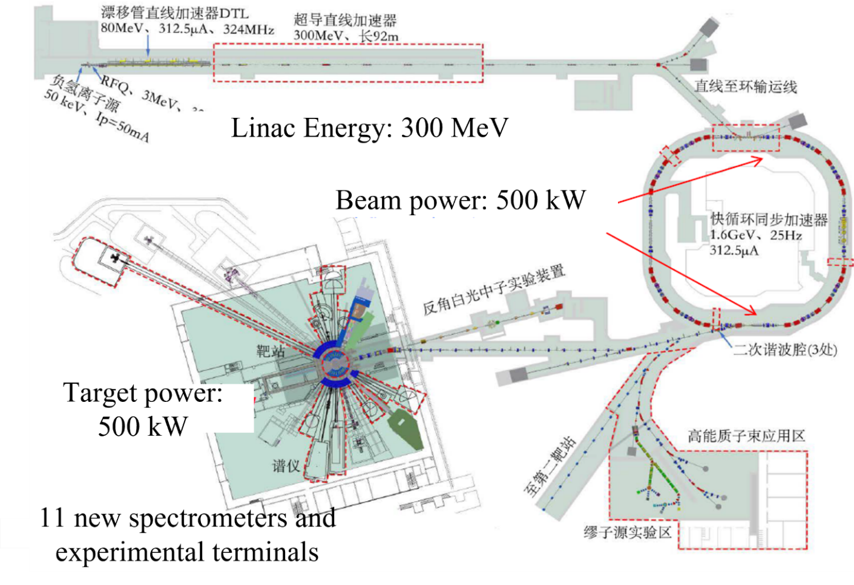
Upgrade of the China Spallation Neutron Source
Parameter | CSNS | CSNS-II
Beam power (kW) | 100 | 500
Repetition rate (Hz) | 25 | 25
Target number | 1 | 1
Ave. beam current (uA) | 62.5 | 312
Extraction beam energy (GeV) | 1.6 | 1.6
Injection beam energy (MeV) | 80 | 300
Spectrometer number | 3 | 11+9

Slide 6
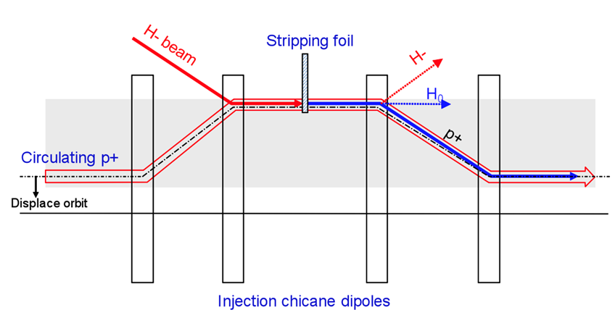
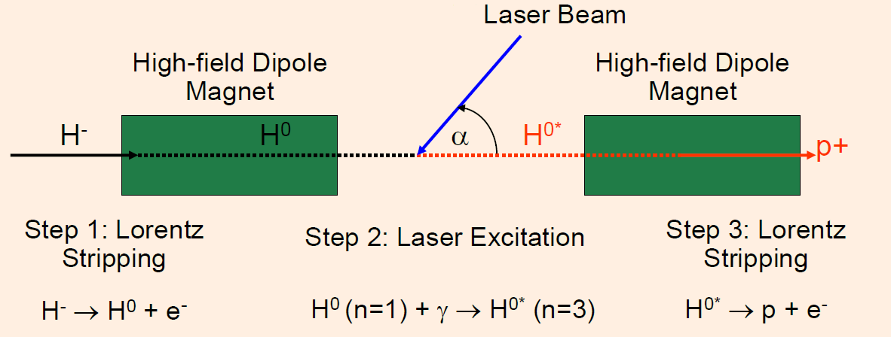
H⁻ stripping
H⁻ Stripping: The Linac accelerates the H⁻ beam. During the preparation for injecting into the RCS, the H⁻ particles are stripped into protons, which then enters the ring through a multi-turn injection method.
Two methods：foil stripping injection, laser-stripping injection.
Foil stripping injection
Laser-stripping injection

Slide 7
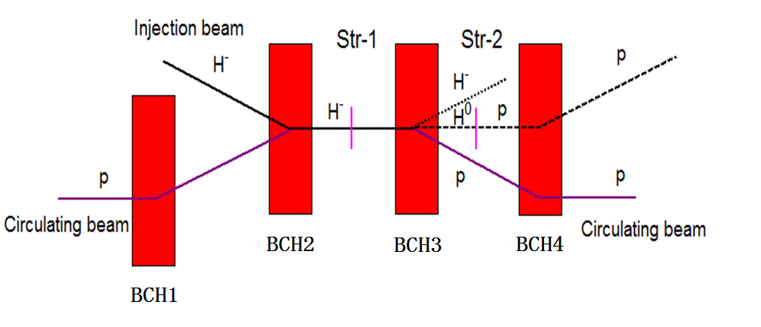
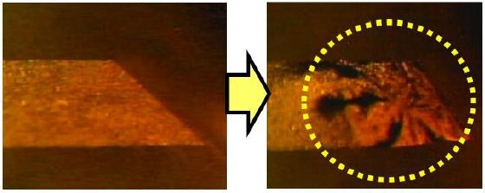
H⁻ stripping for the CSNS-II
Disadvantages of foil stripping: short lifetime, failure at high temperatures (limiting beam power and density), large beam loss and radiation dose.
Laser-assisted H⁻ stripping injection method can solve the defects of the foil stripping.
H⁻ stripping scheme：foil stripping
Stripping foils: a primary foil and an secondary foil
 | Material | Structure | Thickness | Stripping efficiency
Primary foil | HBC | Double-layer | 260 ug/cm² | 99.7%
Secondary foil | HBC | Double-layer | 450 ug/cm² | 100%

Slide 8

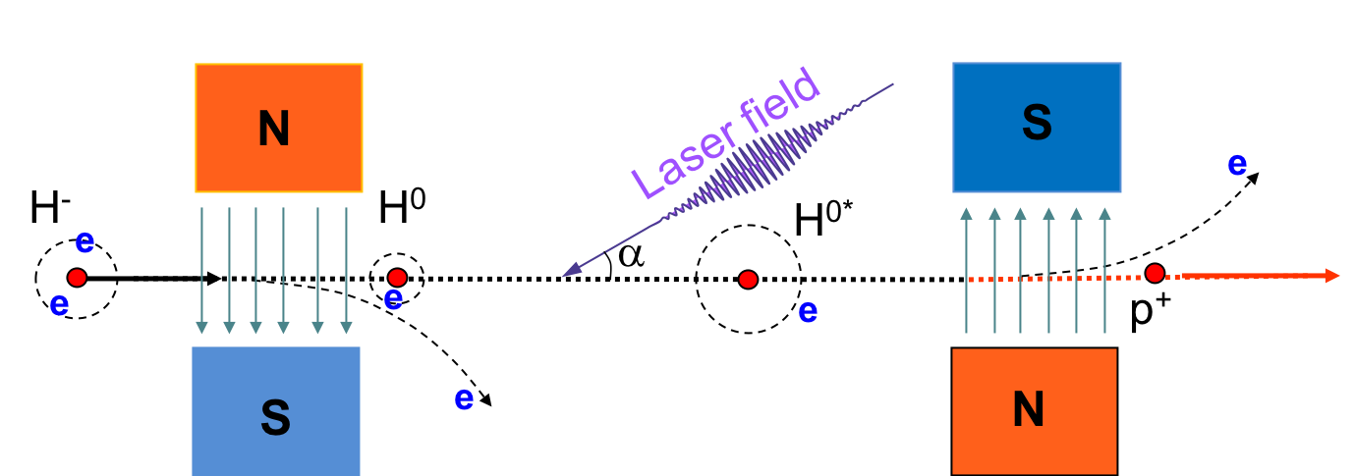
II. Laser stripping injection for the CSNS-II
The integration of the laser and dipole magnet can be used to replace the traditional foil stripping injection method.
To I-Dump
To Ring
n=1→3
Lorentz stripping
Laser excitation
Lorentz stripping

Slide 9
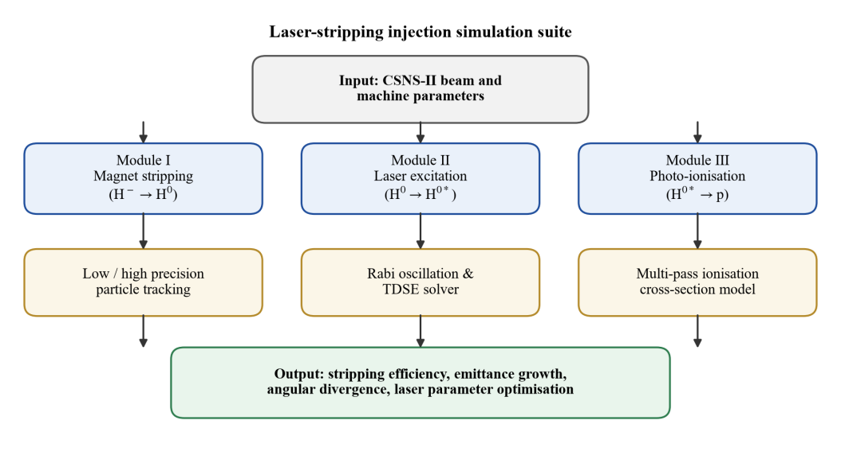
2.1 Simulation codes
A simulation code covering magnetic stripping, laser excitation, and photoionization was developed in hybrid Python/MATLAB. All modules share beam-parameter and magnetic-field data interfaces and can run standalone or in combined iterations.

Slide 10
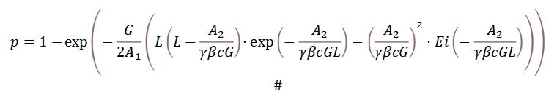
For a trapezoidal magnetic field, there exists an analytical solution for the stripping efficiency, which is used as the verification standard.
Verification of the magnet stripping simulation code
Table. Parameters of trapezoidal magnetic field (Values in bold are analytical results)
gradient | Field length | Stripping efficiency | Average angle spread | RMS angle spread
T/m | mm | % | mrad | mrad
10 | 200 | 99.99593/99.99593 | 38.31099 | 7.21655
20 | 100 | 99.36204/99.36204 | 21.11151 | 4.14564
30 | 70 | 99.57821/99.57921 | 15.33314 | 3.06230
40 | 60 | 99.99993/99.99993 | 12.19231 | 2.50208
$$\begin{aligned}p=1−\exp\left(−\frac{G}{2A_{1}}\left(L\left(L−\frac{A_{2}}{γβcG}\right)⋅exp\left(−\frac{A_{2}}{γβcGL}\right)−{\left(\frac{A_{2}}{γβcG}\right)}^{2}⋅Ei\left(−\frac{A_{2}}{γβcGL}\right)\right)\right) \\ \#\end{aligned}$$
The results calculated by the code show no different from the theoretical results in the first four significant figures, verifying the correctness of the code.

Slide 11
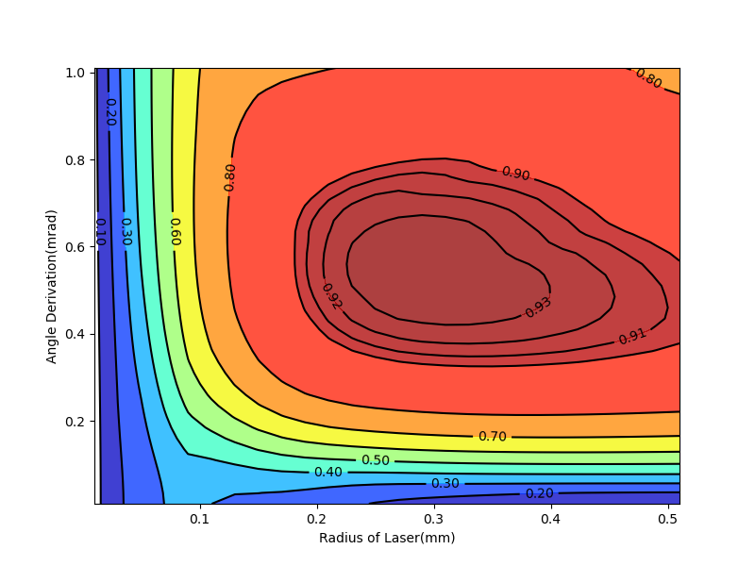
The laser parameters (radius and angular divergence) are changed to optimize the excitation efficiency
Verification of the laser excitation code
 | parameter | Unit | value
beam | energy | GeV | 0.982
 | X-beta | m | 1
 | X-emittance | mm.mrad | 0.09
 | Y-beta | m | 1
 | Y-emittance | mm.mrad | 0.09
 | D | m | 0
 | D’ | rad | -2.7
laser | power | MW | 2
 | length | nm | 355
 | Waist radius | mm | 0.7
 | radius | mm | 0.25
 | angular divergence | mrad | 0.43
 | RMS pulse | ps | 35
By using the SNS parameters and results, the laser excitation code has been verified

Slide 12
2.2 Laser stripping injection for the CSNS
 | CSNS | CSNS-II
Injection beam energy (GeV) | 0.08 | 0.3-0.4
Average beam current (uA) | 62.5 | 312.5
Particle per pulse | 1.56×10¹³ | 7.8×10¹³
Repetition rate(Hz) | 25 | 25
Beam width(us) | 390 | 500
Injection beam size (1σ) (mm) | 1.0 | 1.5
Ion source type | Penning | RF Volume
The injection beam energy of the CSNS-II is approximately increased by 4 times, and the injection beam power is approximately increased by 20 times.

Slide 13
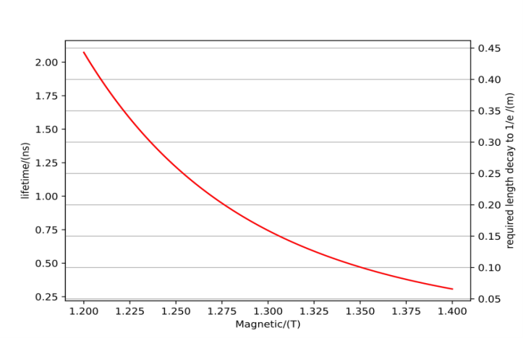
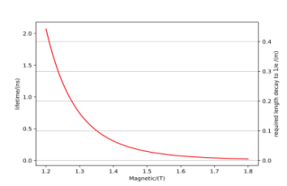
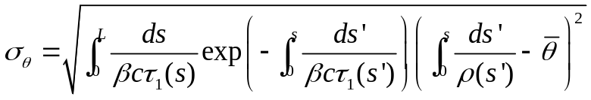
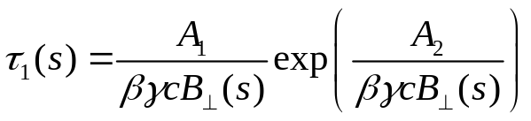
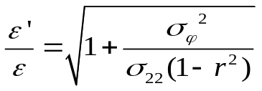
2.2.1 Lorentz stripping
N
e
e
e
e
e
e
e
e
Real field
S
RMS angular dispersion caused by beam separation at different positions :
The particle lifetime in magnetic field：
RMS emittance growth:

Slide 14
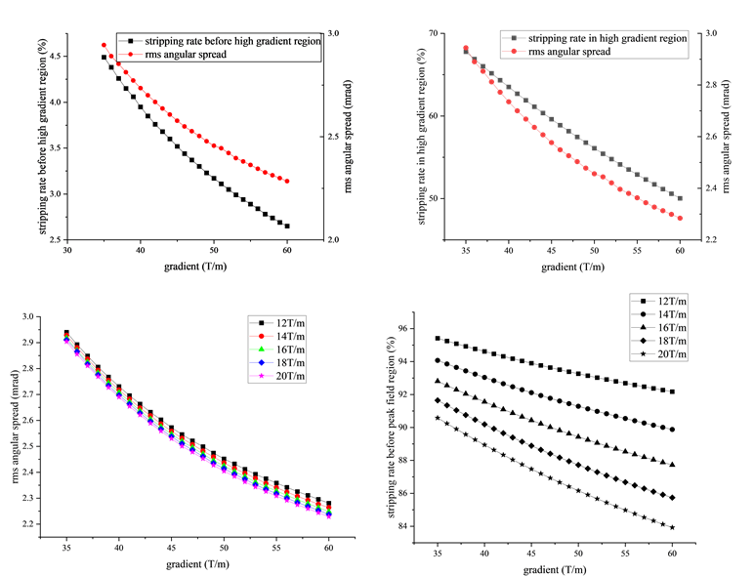
Design requirements for the stripping magnet
Constraints for the new dipole magnet:
  The magnetic field stripping rate in the region below 1.4T is about 7% or less; its effect on increasing the gradient is limited.
  The fringe field stripping rate exceeds 90%.
  The main optimization is the gradient of the magnetic field between 1.4T and 1.8T.
Range | gradient
Lower than 1.4 T | ≥80T/m
1.4 T-1.8 T | ≥60T/m
Upper than 1.8 T | ≥20T/m

Slide 15
Design goals of the stripping magnet
The design indicators in the two stages : RMS angular divergence of 3.10 mrad and 1.91 mrad respectively.
The main magnetic field region: between 1.4 T and 1.8 T.
The magnet design should focus on increasing the magnetic field gradient in this region.
When the RMS angular divergence is set to 1.91 mrad, the magnetic field gradients in the main region (1.4 – 1.8 T) must be strictly controlled.

Slide 16

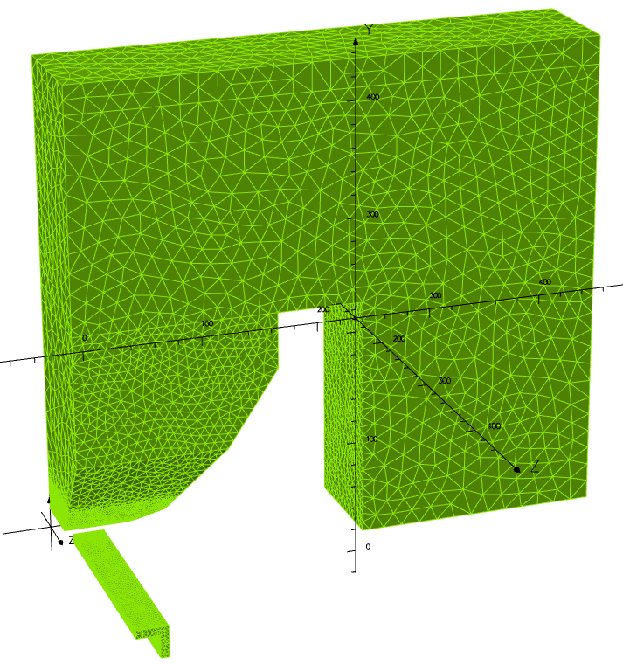
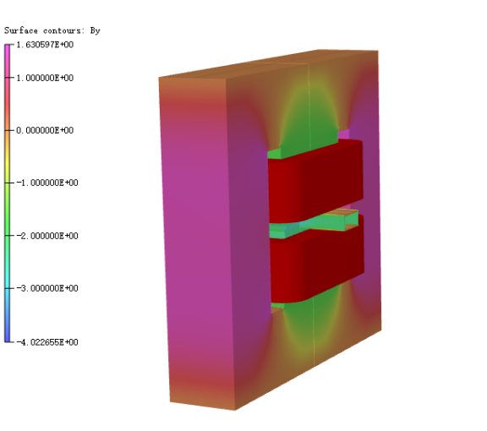
(1) Electromagnet
Optimization goal: improve the fringe field gradient
Methods to improve the fringe field gradient:
  Add shielding bodies
  Adopt unilateral shimming
  Similar to quadrupole chamfering
Magnet
Coil
Full Magnet Geometric Model
1/8 Magnet Geometric Model

Slide 17
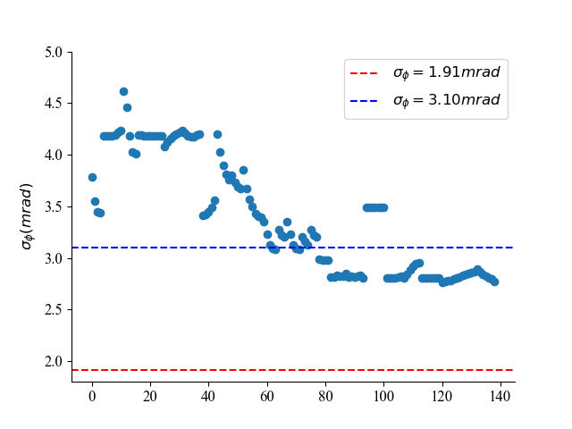
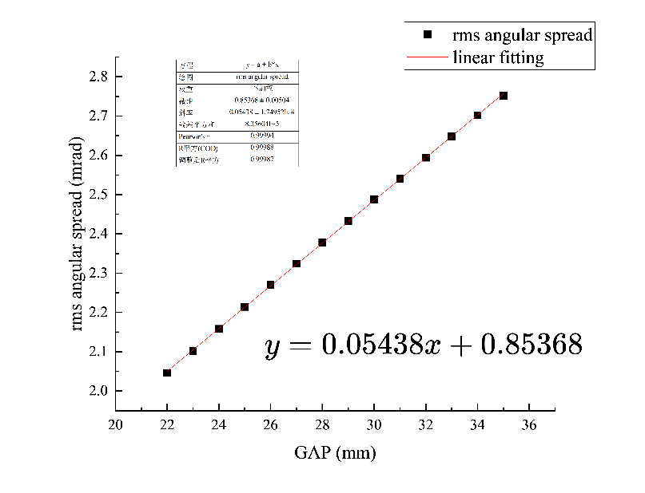
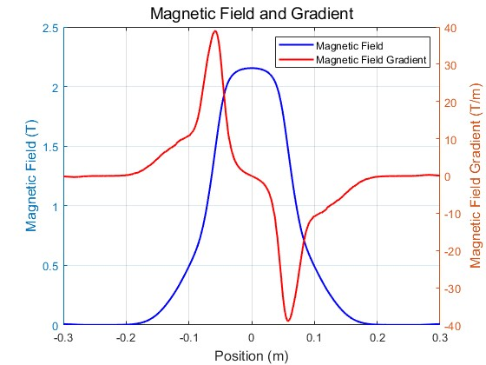
Design of the stripping electromagnet
RMS angular divergence during the magnet iteration process
RMS angular divergence V.S. magnet aperture
Magnetic field distribution
When the aperture of the electromagnet is 26 mm, the peak magnetic field gradient does not exceed 40 T/m, which fails to meet the second-stage design requirement of the RMS angular divergence (1.91 mrad). Therefore, a new design of permanent magnets need to be studied.

Slide 18
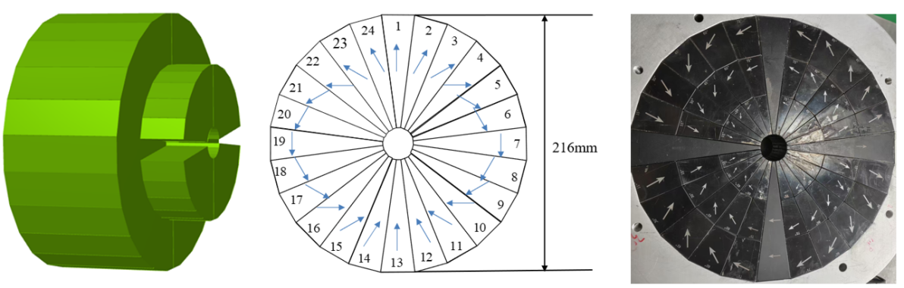

(2) Permanent magnet
Considering the beam aperture and magnet size, a Halbach-type dipole magnet was selected as the main stripping magnet
The peak field at the aperture center is jointly determined by the remanence of the magnet material, the number of array elements, and the ratio of outer to inner radii. It can be tuned by adjusting this ratio
216mm
166mm

Slide 19
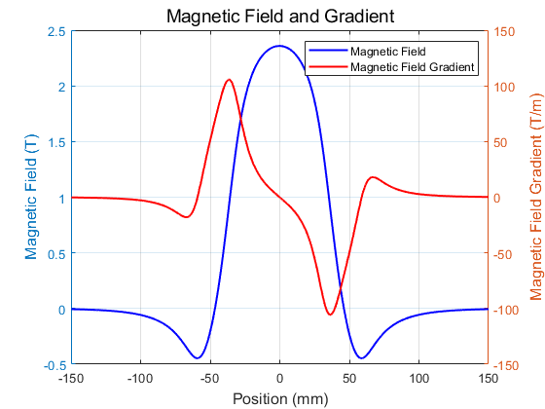
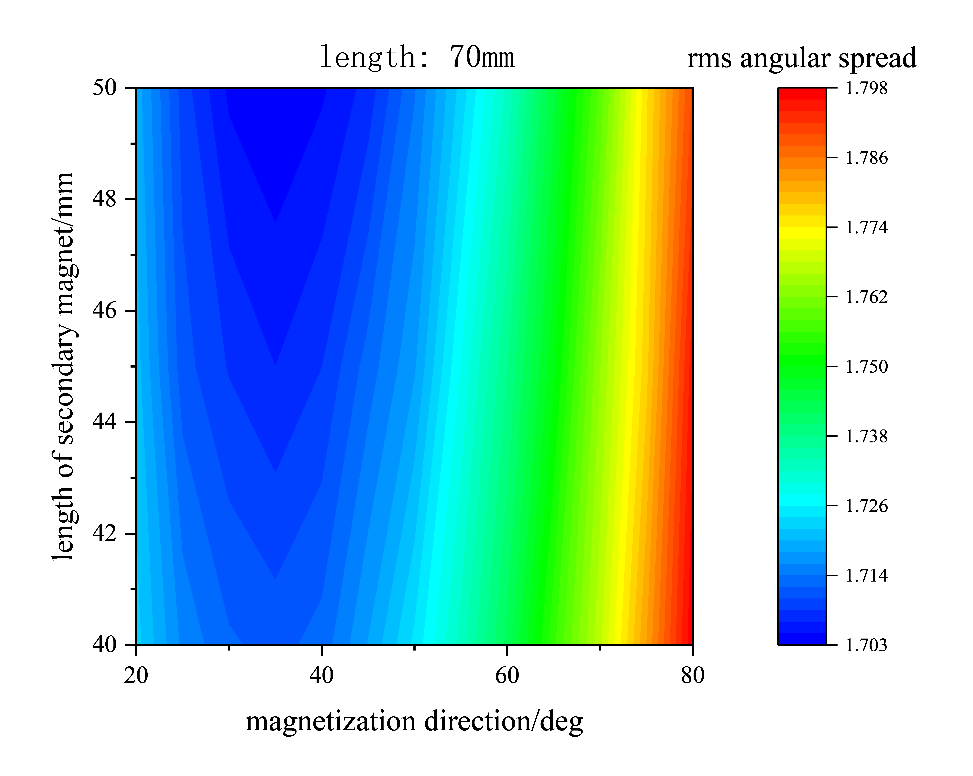
Stripping permanent magnet scheme
The peak magnetic field strength of the laser stripping permanent magnet reaches 2.358 T, and the magnetic field gradient in the main stripping region is 61.80 T/m.
The selection of magnetization direction is determined by the stripping results. The optimal range 30°~ 40°for reducing the growth of RMS angular divergence is chosen.

Slide 20
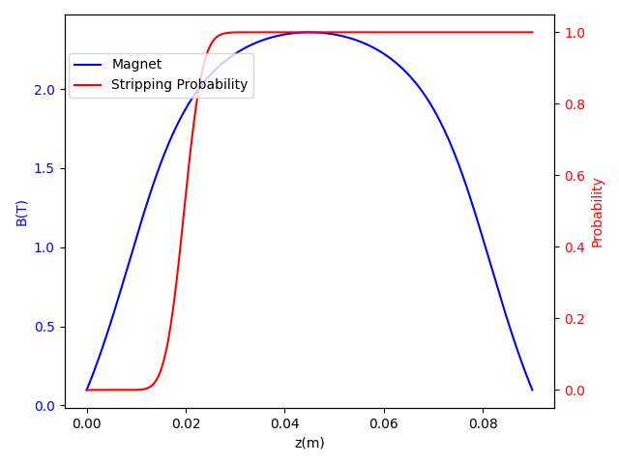
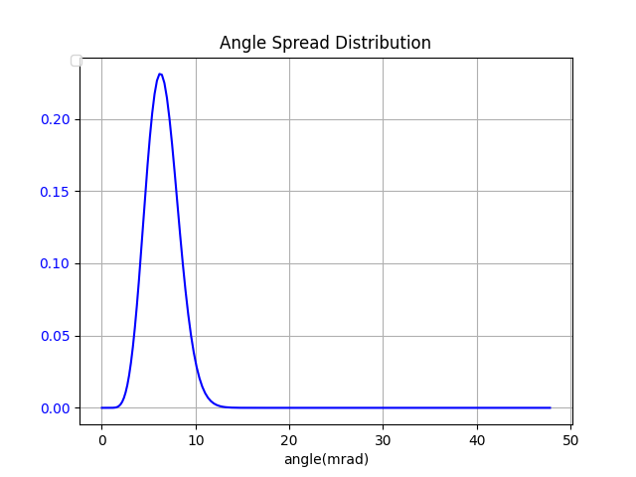
Stripping permanent magnet analysis
Magnetic strength V.S. stripped probability
Stripped angular distribution
The H⁻ particles complete the stripping process in the high-gradient region which is before the peak magnetic field region. All H⁻ particles are converted into H⁰ particles, which no longer deflect, thereby reducing the emittance growth.
By designing a high-gradient magnetic field, the angular divergence distribution achieves the expected Gaussian distribution.

Slide 21
Stripping permanent magnet parameters
Parameter | Value
Peak field strength | 2.35852 T
Peak field gradient | 104.589 T/m
Field gradient at 1.8 T | 61.8022 T/m
Field gradient at 1.4 T | 92.2427 T/m
Integrated field | 0.12571 T.m
Maximum field error | 0.04883 T
Parameter | Value
Stripped efficiency | 99.9999%
RMS angular divergence | 1.693(±2%) mrad
Average angular deflection | 2.180(±7%) mrad
RMS emittance ratio | 5.615(±1.95%)

Slide 22
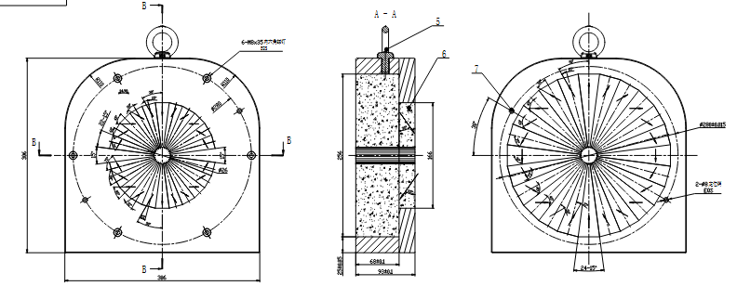
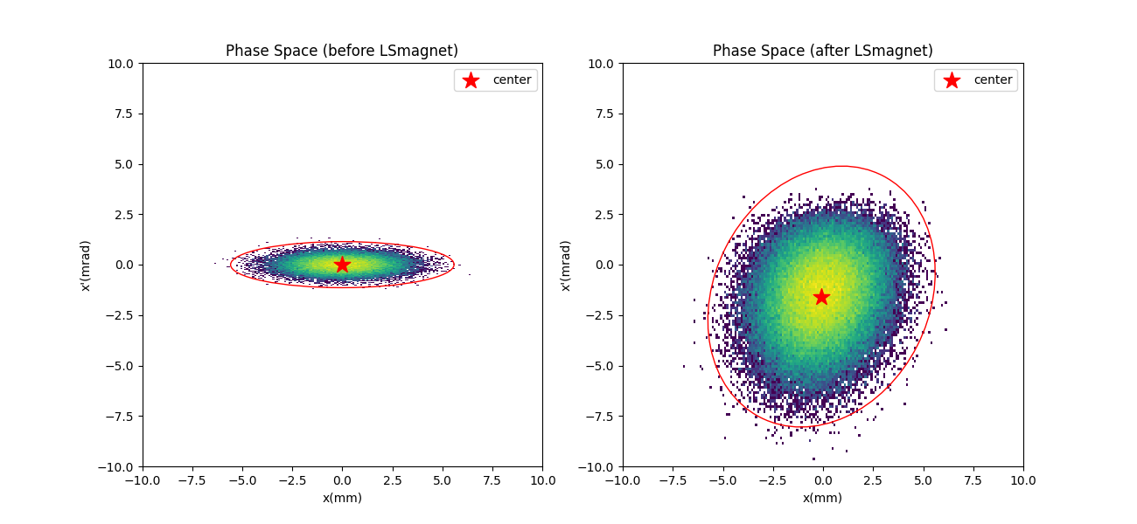
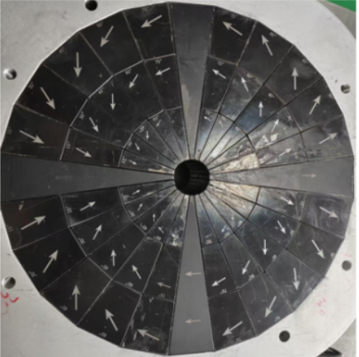
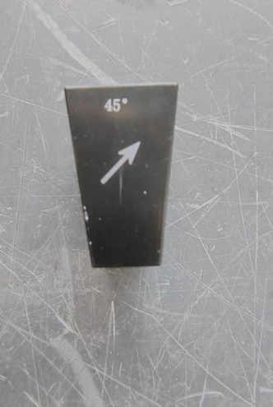
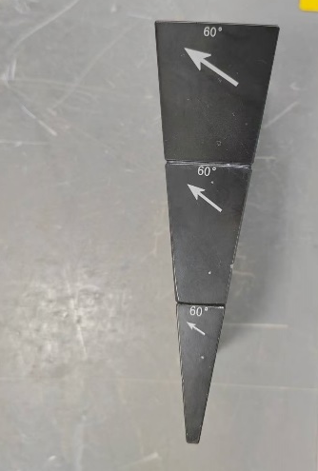
Permanent magnet prototype
Difference in the phase space
Schematic drawing of the magnet
RMS emittance ratio is 5.615

Slide 23
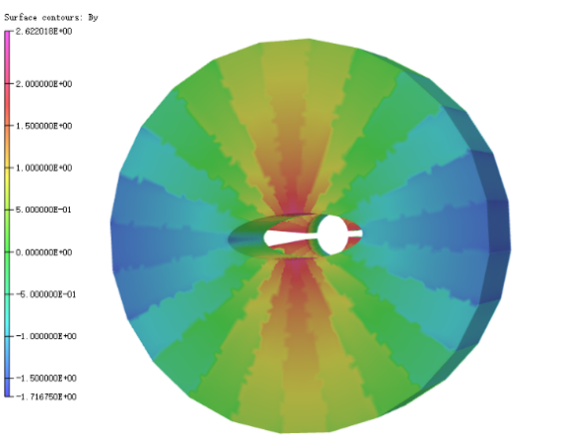
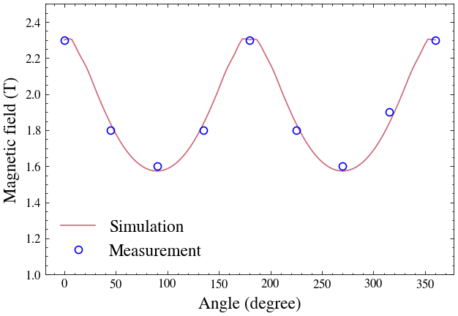
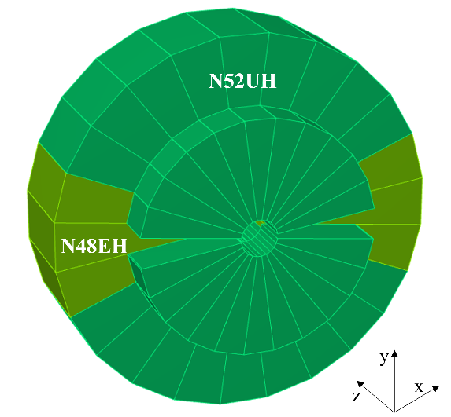
Demagnetization Issue
After the prototype magnet was built, demagnetization was observed at the mid-plane
A demagnetization model was established; simulations agree with measurements, and the magnet design was optimized accordingly

Slide 24
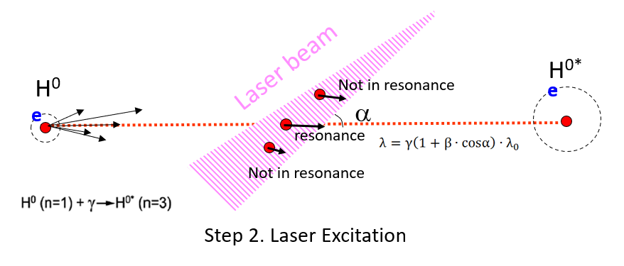
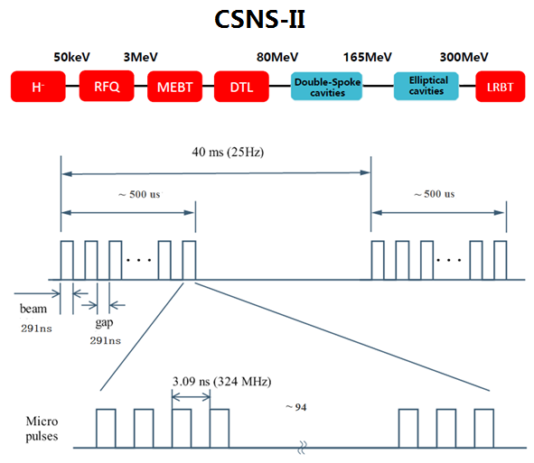

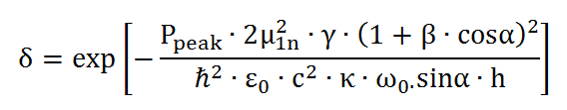

2.2.2 Laser excitation
Peak power of the laser：
Proportion of hydrogen atoms in the ground state：
Average power of the laser：

Slide 25
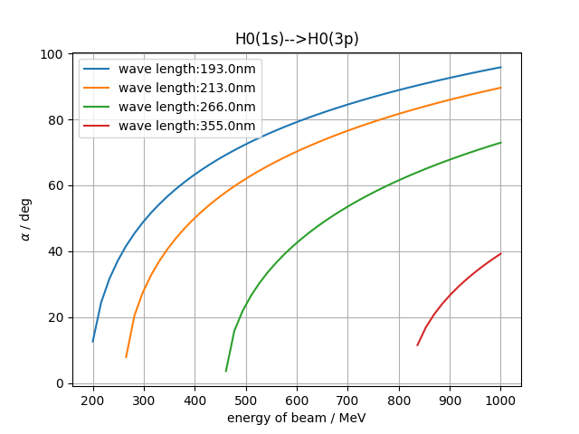
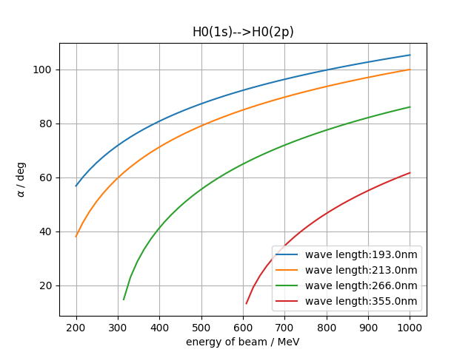


For the H⁻ beam, if one chooses direct excitation to the n=3 state in a single step, a minimum of 213 nm laser wavelength is required. If a stepwise excitation approach is selected, first exciting the hydrogen atoms to the n=2 state, the required laser wavelength can be extended to 266 nm.
Laser excitation process

Slide 26
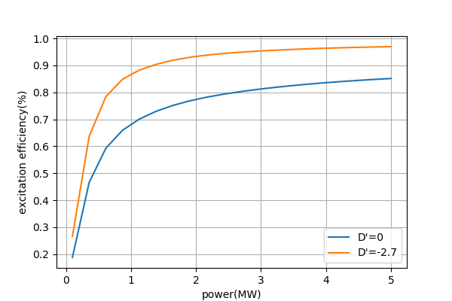
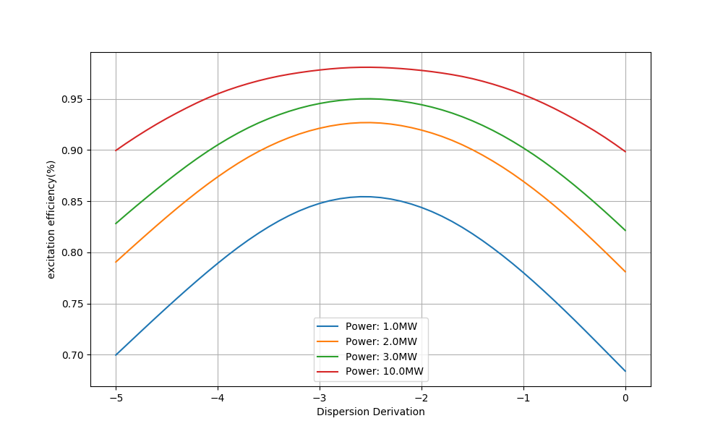


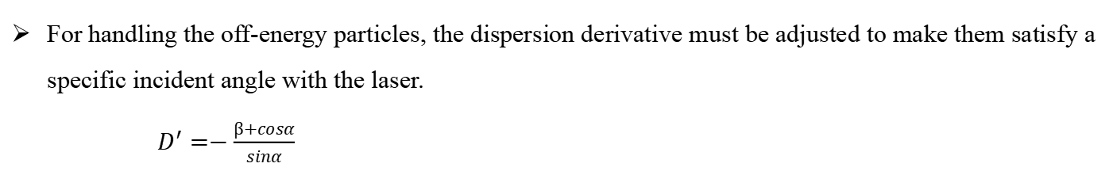




Dispersion derivative
For handling the off-energy particles, the dispersion derivative must be adjusted to make them satisfy a specific incident angle with the laser.
$D^{′}=−\frac{β+cosα}{sinα}$
$$γ_{1}$$
laser
$$H^{0}$$
$$γ_{2}$$
$$α$$
$$H^{0∗}$$
$$γ_{n}$$
Impact of D` on excitation efficiency

Slide 27
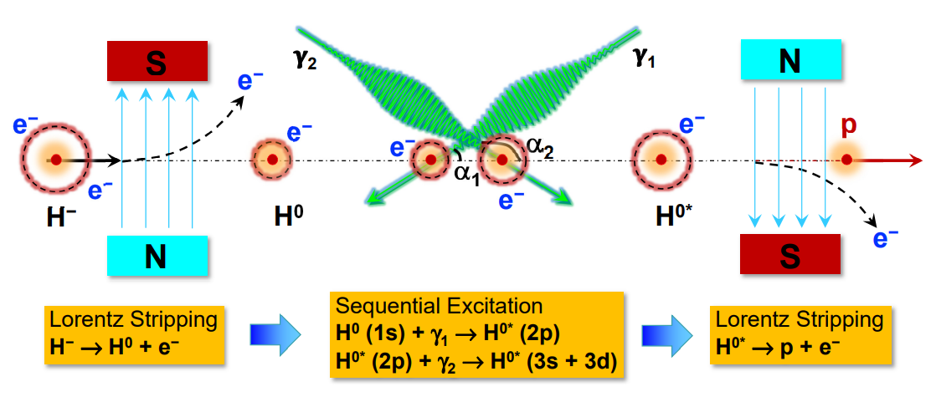
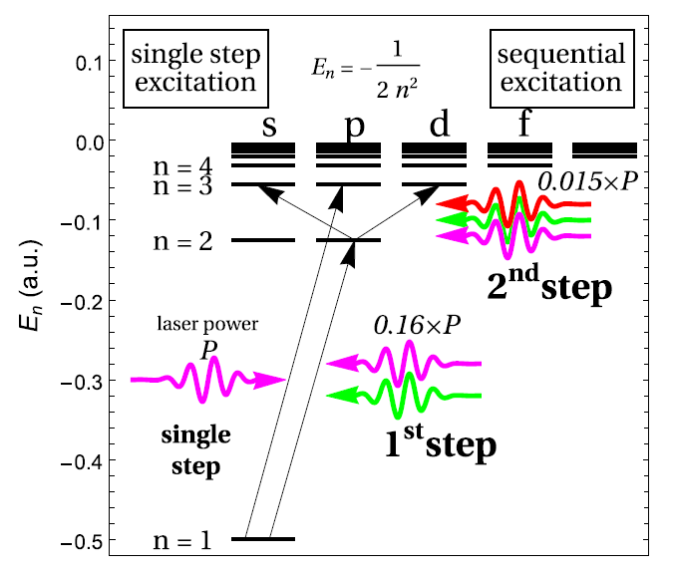
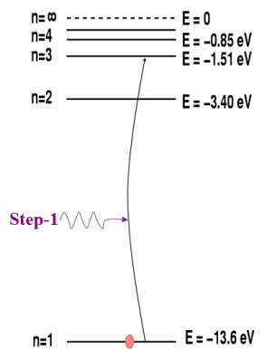
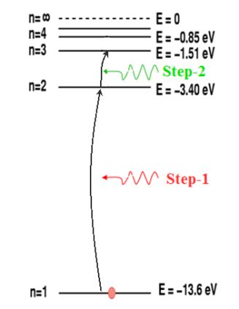
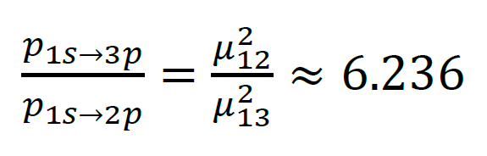
Laser scheme with sequential excitation
Refer to SNS
Advantages of the sequential resonance scheme:
  Lower power required for each excitation
  Increase the flexibility in laser wavelength selection

Slide 28
Single vs. sequential excitation for CSNS-II
Parameter | Single excitation | Sequential excitation
 | 1s→3p | 1s→2p | 2p→3d
Transition energy ΔE | 12.09eV | 10.20eV | 1.89eV
Transition wavelength | 102.6 nm | 121.5 nm | 656.1 nm
Laser wavelength λ | 213 nm | 266 nm | 532 nm
Laser incident angle α | 50.11⁰ | 41.31⁰ | 127.24⁰
Peak power (Stripping efficiency 99%) | 2.97 MW | 311.10 kW | 70.13 kW
Micro-pulse energy (Stripping efficiency 99%) | 24.06 uJ | 2.52 uJ | 0.57 uJ
Meso-pulse energy (Stripping efficiency 99%) | 9.18 mJ | 0.96 mJ | 0.22 mJ
Macro-pulse energy (Stripping efficiency 99%) | 864.27 mJ | 90.53 mJ | 20.41 mJ

Slide 29
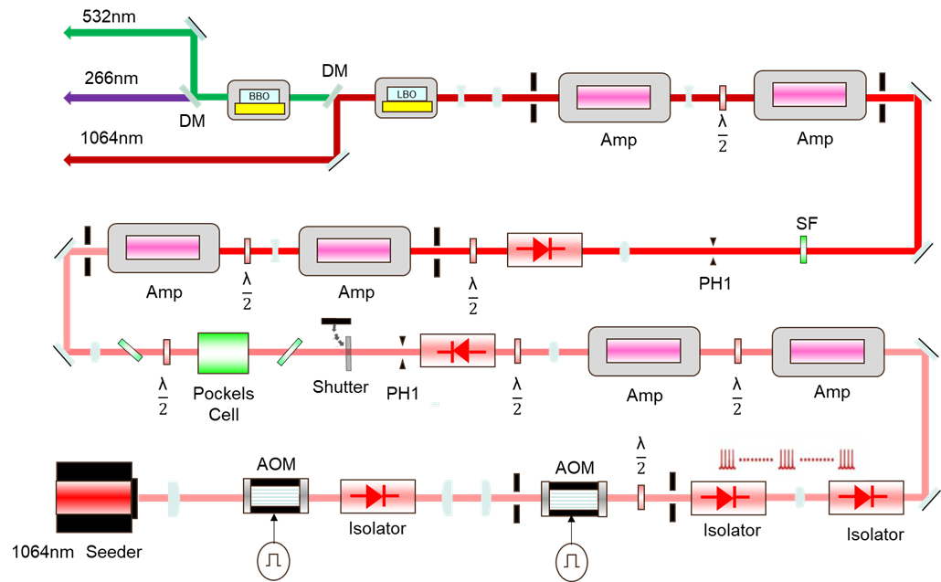
Design of the Laser Excitation Beam Line
The laser system adopts a master oscillator power amplifier (MOPA) scheme
It not only produces laser with the same time structure as the H⁻ beam, but also meets the laser power requirement for efficiently stripping the H⁻ beam
The beam time structure comprises macro-pulses, intermediate pulses, and micro-pulses
The required wavelength can be obtained by fourth harmonic generation of a common high-power pulsed Nd:YAG laser

Slide 30
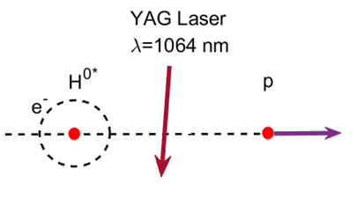


2.2.3 Third stage stripping process
Difficulties by using magnet stripping for the third stage stripping:
  The inner diameter of the magnet in the third stage stripping needs to be extremely large, and the stripping magnet will also affect the circulating beam.
  The protons stripped at the initial stage are highly susceptible to magnetic fields, resulting in a significant increase in angular dispersion.
YAG laser stripping is considered for the third stage stripping.

Slide 31

Third stage stripping: multiple reflections
Laser
Hydrogen beam
Proton beam
The role of multiple reflections in reducing laser pulse energy
Establishing a suitable mirror system:
  Improving the utilization efficiency of laser energy.
  Reducing the requirement for laser pulse power.

Slide 32
Third stage laser stripping parameters
Parameter | value
Interaction cross-section | 3.3×10⁻¹⁷ cm²
Micro pulse width of H⁻ beam | 8.1 ps
Interaction time | 15 ps
Laser pulse width | 23.1 ps
Laser cross-sectional radius | 1.6 mm
Laser wavelength | 1064 nm
Incident angle | 97.25º
Laser power (reflection 24) | 1.25 MW

Slide 33

2.3 Design scheme of the laser-stripping for the CSNS-II
Considering the new injection system layout and beam parameters, a new laser stripping injection scheme is proposed
Three-stage stripping: H⁻ ions are converted to neutral H atoms by a magnet, excited to the second excited state via two-step sequential excitation, and ionized to protons by an infrared laser
Advantages
Reduced the laser power
Improved safety
Good engineering feasibility
Good installation compatibility

Slide 34
III、Summary
A brief introduction was provided to the CSNS H⁻ charge exchange injection method.
Based on in-depth research and detailed simulations, a design scheme of the laser stripping injection for the CSNS-II has been proposed.
The stripping magnet prototype has been fabricated, and demagnetization was observed in some regions. A redesigned magnet was developed to resolve the demagnetization issue.
Thank you for your attention!

